Slide 1

QuickServe
Localized Service Discovery & Booking Application
Presented by(TEAM D)
Bhoomi Mishra
Dasari Lavanya
Sowmya Deva
Indhu M
Navya Sri R

Slide 2
THE PROBLEM
Challenges in Local Service Booking
Finding reliable local service providers remains a frustrating experience for millions of users. The current landscape lacks transparency, trust, and convenience, creating barriers that waste time and undermine confidence.
Discovery Gap
Price Opacity
Trust Deficit
Manual Hassle
Difficulty finding reliable local service providers in your area
Lack of transparent, upfront pricing information
No proper review or rating system to verify quality
Time-consuming booking process with multiple phone calls
Platform Fragmentation
Accountability Issues
No centralized platform connecting agencies and independent workers
Limited trust and accountability mechanisms

Slide 3
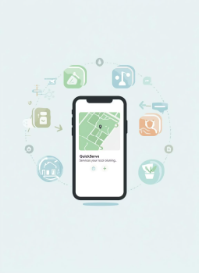
OUR SOLUTION
A Comprehensive Platform for Local Services
QuickServe transforms the local service booking experience by connecting users with trusted providers through an intelligent, secure, and transparent platform.
Smart Discovery
Instant Booking
Location-based service discovery helps you find nearby trusted providers in seconds
Real-time booking system with instant scheduling confirmation and availability updates
Trust & Verification
Secure Payments
All workers are verified with comprehensive ratings and authentic customer reviews
Safe online payment processing with multiple payment options and financial protection
Flexible Provider Types
Full Transparency
Support for both individual independent workers and established service agencies
Upfront pricing with no hidden fees and real-time service tracking from start to finish

Slide 4
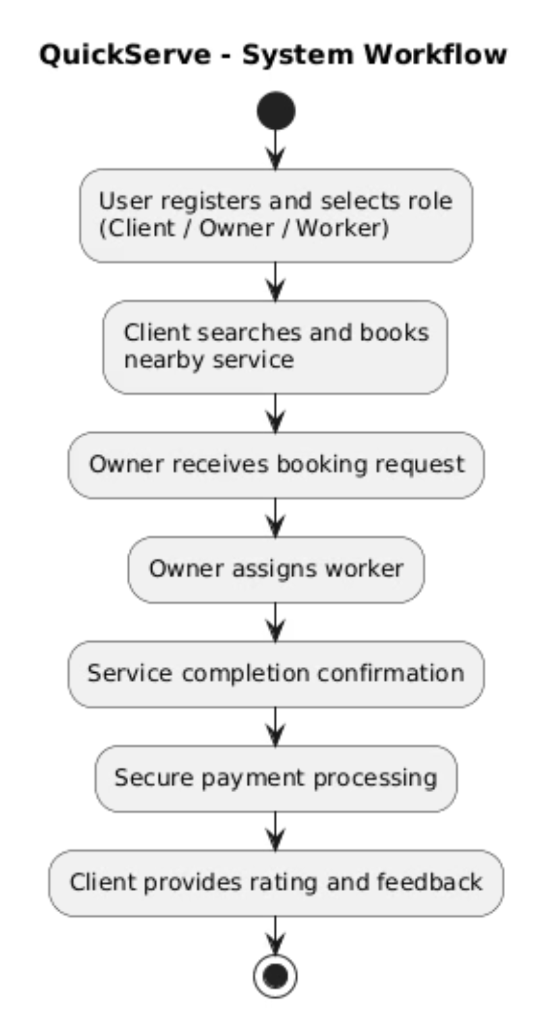
System Workflow
QuickServe streamlines the entire service booking journey from initial registration to final feedback, creating a seamless experience for all participants.
01
Registration
User registers and selects their role: Client, Owner, or Worker
02
Service Search
Client searches and books nearby services based on location and category
03
Job Assignment
Owner receives the request and assigns the most suitable worker
04
Service Delivery
Worker completes the service and confirms completion in the system
05
Payment
Secure payment is processed through the platform's payment gateway
06
Feedback
Client provides rating and detailed feedback to build trust

Slide 5




User Roles & Perspectives
QuickServe supports four distinct user roles, each with tailored features designed to meet their specific needs and workflows.
Client
Owner
Worker
Admin
Searches and books services easily
Makes secure online payments
Tracks real-time booking status
Provides ratings and reviews
Manages services and workers
Accepts booking requests
Assigns jobs to available workers
Tracks revenue and performance
Accepts assigned jobs
Completes services professionally
Tracks personal earnings
Builds reputation through ratings
Verifies users and service providers
Monitors all bookings and payments
Manages service categories
Handles disputes and reports

Slide 6







FEATURES
Key Features
QuickServe delivers a comprehensive suite of features designed to create trust, convenience, and transparency throughout the service booking experience.
Role-Based Login
Location-Based Search
Online Booking
Secure Payment
Users access features specific to their roles, ensuring tailored experiences and enhanced security
Services are easily discoverable based on your geographic location for maximum convenience
Clients can quickly book services through the app with real-time availability updates
Safe online transactions protect users' financial information during all bookings
Real-Time Updates
Ratings & Reviews
Instant notifications about bookings, changes, and service status keep everyone informed
Customers share their experiences, helping others choose trusted service providers

Slide 7

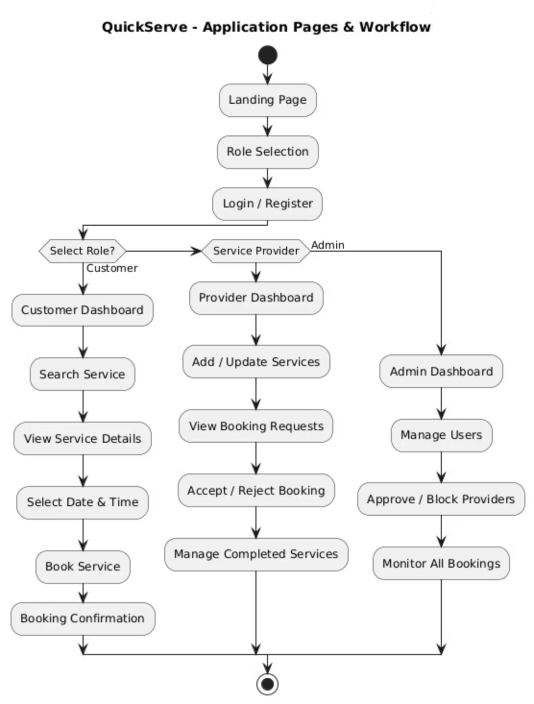
Application Workflow
The application is designed with distinct workflows for each user type, ensuring an optimized experience from landing to completion.
Main Flow
Service Provider Workflow
Landing page introduction
Role selection (Customer / Provider / Admin)
Login or register for new users
Access role-based dashboard
Add and update service offerings
Set availability calendar
View incoming booking requests
Accept or reject bookings based on capacity
Manage worker assignments
Customer Workflow
Search services by category or location
View detailed service information
Select preferred date and time
Confirm booking and make payment
Track booking status in real-time
Admin Workflow
Manage all system users
Approve or block service providers
Monitor all platform bookings
Resolve disputes and handle reports

Slide 8

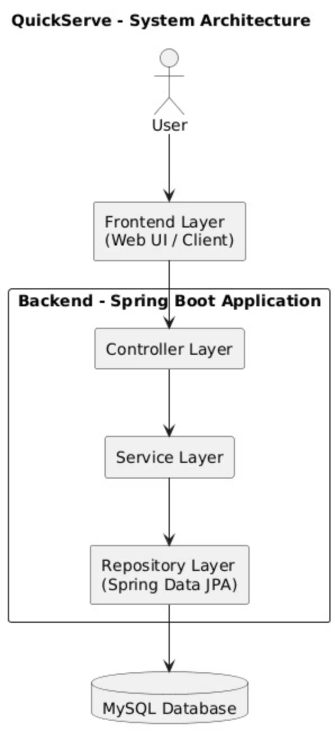

ARCHITECTURE
System Architecture
QuickServe follows a layered architecture pattern to ensure clean code structure, maintainability, and scalability as the platform grows.
Controller Layer
Handles all HTTP requests, receives data from the frontend, and sends appropriate responses back to users
Service Layer
Contains core business logic, processes booking rules and workflows, and validates all incoming data
Repository Layer
Interacts directly with the database and performs all CRUD operations using Java Persistence API (JPA)
Database (MySQL)
Stores all user details, service information, booking records, and transaction history securely

Slide 9

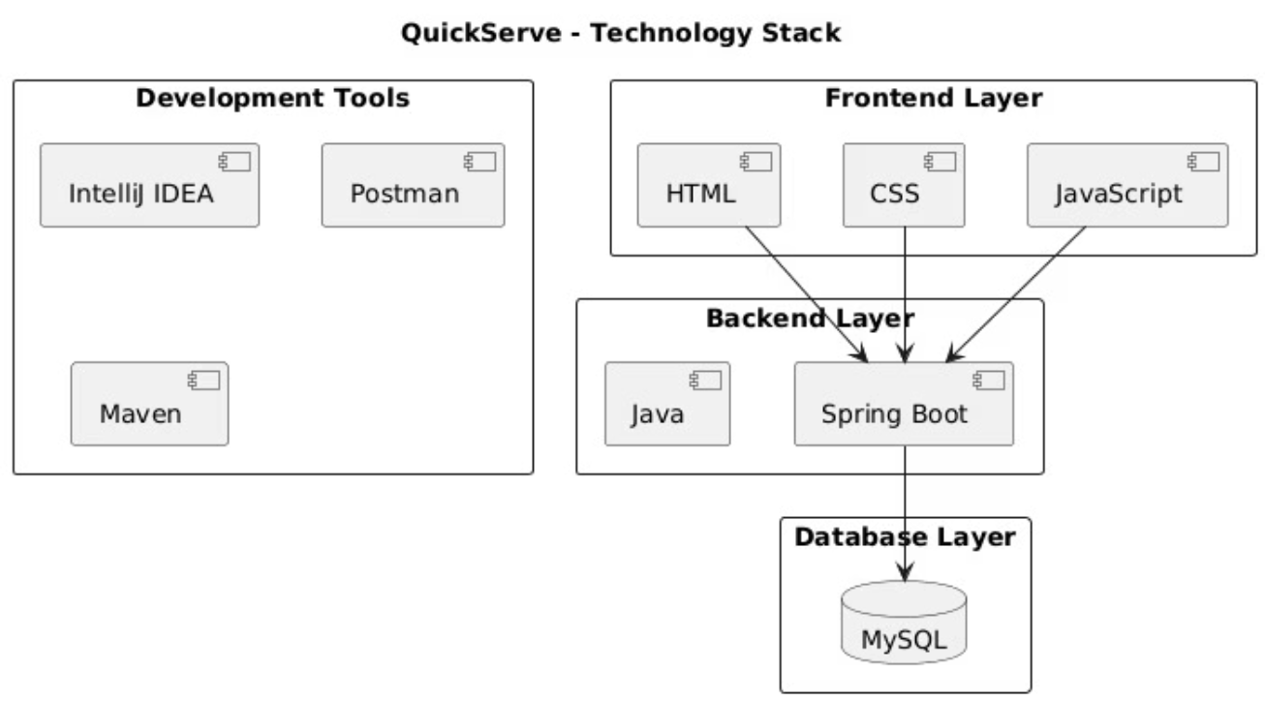



Technology Stack
QuickServe is built using modern, industry-standard technologies that ensure reliability, performance, and scalability.
Frontend
HTML – Semantic structure of all web pages
CSS – Modern styling and responsive layout design
JavaScript – Handles dynamic user interactions and REST API calls
Backend
Java – Core programming language for business logic
Spring Boot – Powerful framework for building RESTful APIs
Database
MySQL – Robust relational database for storing all application data
Development Tools
VS Code / IntelliJ IDEA – Code editors
Postman – API testing and validation
Maven – Dependency management and build automation

Slide 10
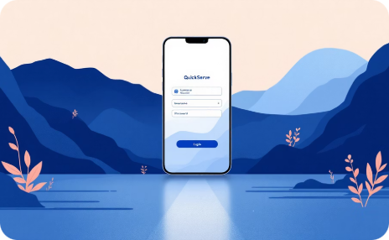
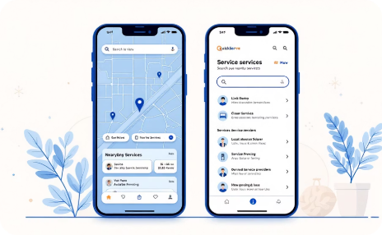
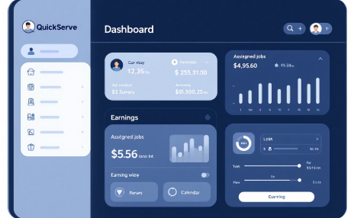
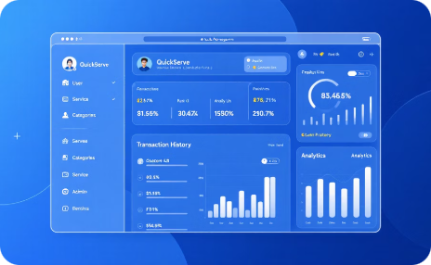
Application Pages in Action
Experience QuickServe's intuitive design and streamlined user flows through key application screens, ensuring a smooth journey for all roles.
Login & Registration
Service Booking
Worker Dashboard
Admin & Owner Panels
A clean and secure entry point for all users, supporting seamless sign-up and login with role selection.
Clients can easily search for services, view provider details, and book appointments in real-time within their local area.
Workers manage their assigned jobs, track earnings, update availability, and view performance metrics.
Administrators and Owners have dedicated dashboards to manage users, services, finances, and platform operations.

Slide 11







WHAT'S NEXT
Future Enhancements
Our roadmap includes powerful features that will elevate QuickServe into a comprehensive, world-class local services marketplace platform.
Payment Gateway Integration
Enhanced Ratings System
Email & SMS Notifications
Live Availability Updates
Providing real-time availability will enhance user convenience and reduce booking conflicts
Integrating a comprehensive online payment gateway will streamline transactions and support multiple payment methods
Expanding ratings and reviews with verified badges will improve service provider transparency and trust
Implementing multi-channel notifications will keep users informed of important updates instantly
Native Mobile App
Cloud Deployment
Developing iOS and Android applications will increase accessibility for users on the go
Utilizing cloud infrastructure will ensure scalability, reliability, and performance as demand grows

Slide 12
CONCLUSION
QuickServe is positioned to revolutionize the local service industry, offering a powerful platform for efficiency and growth.
Seamless Service Experience
QuickServe simplifies the booking, management, and delivery of local services for all users.
Role-Optimized Workflows
Tailored features and dedicated interfaces empower clients, owners, and workers for maximum efficiency.
Robust & Scalable Platform
Built with modern, industry-standard technologies to ensure reliability, performance, and future expansion.
Strategic Vision for Growth
A clear roadmap for continuous enhancement and innovation, securing market leadership.

Slide 13

Thank You for Your Time
We appreciate your attention and valuable insights during this presentation.
QuickServe is designed to transform local services, and we are excited about its potential.
We look forward to discussing how QuickServe can benefit your organization.

